Slide 1
EL1101E: The Nature of Language
AY2024-25, Sem 2
Week 1: Introduction to Linguistics
A/P Rebecca L. Starr
Tutors:
Hasini Makawita, Hui Chi Kin,
Liu Ya, Zeng Hao, Zhang Qingyu

Slide 2
Today
Introducing our teaching team
Defining linguistics
Knowledge of language
Key features of language
A brief history of linguistics
Course logistics

Slide 3
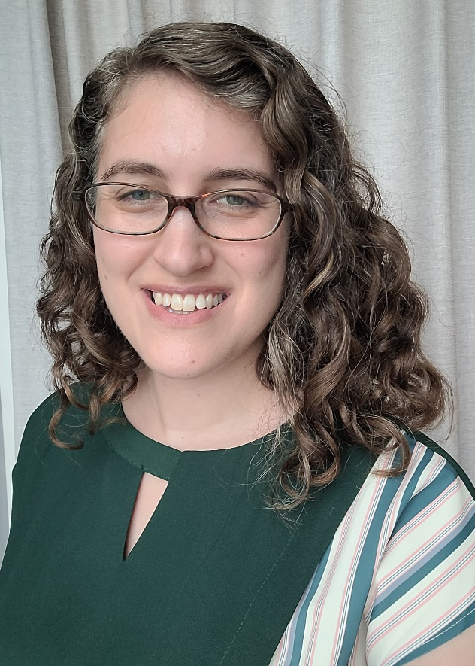
EL1101E Instructor
A/P Rebecca L. Starr
rstarr@nus.edu.sg

Slide 4
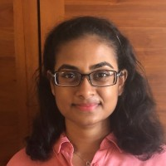



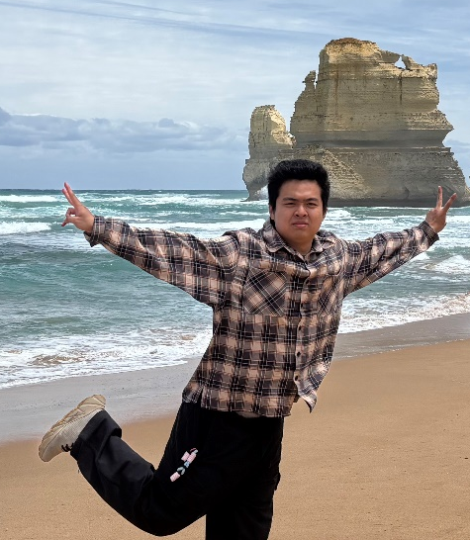
EL1101E Tutors
Hasini Makawita Hui Chi Kin (Ethan)
Liu Ya Zeng Hao Zhang Qingyu (Nick)

Slide 5
What is this course about?
This course is mysteriously titled, “The Nature of Language.”
A clearer (more boring) title would be, “Introduction to Linguistics.”

Slide 6
What is linguistics?
One definition of linguistics: “the scientific study of language as a system.”

Slide 7
What is linguistics?
One definition of linguistics: “the scientific study of language as a system.”
Why “scientific”?

Slide 8
What is linguistics?
One definition of linguistics: “the scientific study of language as a system.”
Why “as a system”?

Slide 9
What is linguistics?
Another definition of linguistics: “the scientific study of language as a system and as a social phenomenon.”

Slide 10
What do we study in linguistics?
Linguists study various aspects of the structure of language, from sound patterns to narratives.

Slide 11
What else do linguists study?
How language is acquired
How it is processed in the brain
How it can be processed by computers
How it changes over time
How it varies by situation
How it functions in society

Slide 12
Some big questions in linguistics
Do all languages share a common underlying structure?
Is the way you think shaped by the language(s) you speak?
Is language learned and processed in the brain differently from other skills?

Slide 13
Do linguists only study English?
No. Linguistics is the study of language in general.
Many linguists are interested in language universals, and therefore study a range of languages to discover patterns.

Slide 14
Will we only learn about English in this course?
This course will focus primarily on English examples, but will not exclusively discuss English.

Slide 15
Do linguists teach people how to speak properly?
No. Linguistics is descriptive, not prescriptive.

Slide 16
Do linguists teach people how to speak properly?
“Grammar” in linguistics refers to the systematic patterns that constitute any particular language variety.

Slide 17
But, some ways of speaking are more grammatical than others, right?
Actually, no.
Standard and non-standard language varieties are equally systematic and rule-governed.

Slide 18
Do linguists learn to speak many languages?
Many linguists do enjoy learning languages.
But linguistics is not about learning to be a translator, or learning lots of languages.

Slide 19
How do linguists study language?
Linguistics involves a wide range of quantitative and qualitative research methods and tools.
Some examples:
Brain imaging (e.g., fMRI)
Acoustic analysis software
Statistical analysis of corpora
Ethnographic fieldwork

Slide 20
What methods will we use in this course?
Most work for this course will involve analytical reasoning: observation of data and identification of patterns.

Slide 21
So, is linguistics in the sciences, social sciences, or humanities?
Linguistics is at the crossroads of many disciplines. Different universities classify it in different ways.
Many students are drawn to linguistics because they are interested in both the sciences and the arts!

Slide 22
Summary of key points
Linguistics is the scientific study of language as a system and as a social phenomenon.
Linguists investigate language patterns using a range of methods.
This course will be awesome.

Slide 23
Knowledge of language
When we say that we know a language, what exactly do we mean that we know?

Slide 24
Knowledge of language
When we say that we know a language, what exactly do we mean that we know?
Two common types of answers:
Function: knowing how to communicate / express yourself.
Form: knowing the words of that language and the rules for putting them together.

Slide 25
Knowledge of language
Beyond knowing “words”, what else do speakers of a language know about the form of their language?

Slide 26

Sounds
Where does “sack” stop and “sock” start?
1 2 3 4 5 6 7 8 9

Slide 27
Sounds
Where does “sack” stop and “sock” start?
1 2 3 4 5 6 7 8 9
Although speech sounds exist on a continuum, speakers of the same language break up this continuum into conventionalized units.
e.g., the vowel in “sack” vs. the vowel in “sock”

Slide 28
Sounds
The study of speech sounds is called phonetics.

Slide 29
Sound patterns
Which of these is most likely to be an English word:
frink
vlorsh
kdvo

Slide 30
Sound patterns
Which of these is most like to be an English word:
frink
vlorsh
kdvo
Our knowledge of English tells us that “frink” is most likely to be a word, even though “vlorsh” is not inherently impossible to pronounce.

Slide 31
Sound patterns
The study of sound patterns is called phonology.

Slide 32

Word structure
By the way, this is a frink:

Slide 33
Word structure
And these are two…

Slide 34
Word structure
We know that the plural of “frink” is most likely “frinks”, even though we have never seen this word before.

Slide 35
Word structure
The study of the structure of words and their parts is called morphology.

Slide 36
Phrases and sentences
Which of these sentences is grammatical:
I yesterday two frinks vargled.
Yesterday I vargled two frinks.
Vargled I yesterday two frinks.

Slide 37
Phrases and sentences
Which of these sentences is grammatical:
I yesterday two frinks vargled.
Yesterday I vargled two frinks.
Vargled I yesterday two frinks.
None of these sentences are “correct” English, since they contain non-words.
Still, we can identify that one has English sentence structure.

Slide 38
Phrases and sentences
The study of the structure of phrases and sentences is called syntax.

Slide 39
Meaning
For each of these sentences, is Joy a doctor?
Joy is pretending to be a doctor.
I realized that Joy was a doctor.
I didn’t realize that Joy was a doctor.
I think Joy is a doctor.
If Joy were a doctor, she’d be a good one.

Slide 40
Meaning
For each of these sentences, is Joy a doctor?
Joy is pretending to be a doctor.
I realized that Joy was a doctor.
I didn’t realize that Joy was a doctor.
I think Joy is a doctor.
If Joy were a doctor, she’d be a good one.

Slide 41
Meaning
Some verbs, like “realize”, are factives, meaning they presuppose that something is true.
Competent speakers of a language understand that certain propositions must be true or false given the truth of an assertion.

Slide 42
Meaning
The study of language and meaning is called semantics.

Slide 43
Meaning in context
Is it possible to “lie” when making the following statements? Why or why not?
Thanks so much.
Delete your account!
I dub thee Sir Prancealot.
Your Honour, I move for a mistrial.

Slide 44
Meaning in context
Is it possible to “lie” when making the following statements? Why or why not?
Thanks so much.
Delete your account!
I dub thee Sir Prancealot.
Your Honour, I move for a mistrial.
These are a special type of statement called a “performative utterance.”
They can perform certain actions, but only when produced in the right context.

Slide 45
Meaning in context
The study of how context contributes to linguistic meaning is called pragmatics.

Slide 46
Summary: Knowledge of language
Phonetics | speech sounds | [s] [l] [aɪ] [d] [z]
Phonology | sound patterns | /slaɪdz/
Morphology | word structure | slide-s
Syntax | sentence structure | “These slides are amazing!”
Semantics | meaning | These slides are a member of the set of all amazing things.
Pragmatics | meaning in context | This is a compliment about the slides.

Slide 47
Some key features of language
Although human languages vary in some respects, they all share several key features.
Let’s review some of the design features of communication systems proposed by linguist Charles Hockett (1960).
While some of these features are shared by animal communication systems, Hockett proposed that human language is unique in having all of them.
Read more here: https://en.wikipedia.org/wiki/Hockett%27s_design_features

Slide 48
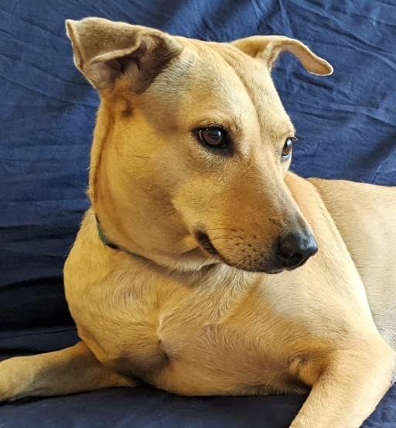
Some key features of language
Feature 1: Arbitrariness
Is there any inherent connection between the word ‘dog’ and…

Slide 49
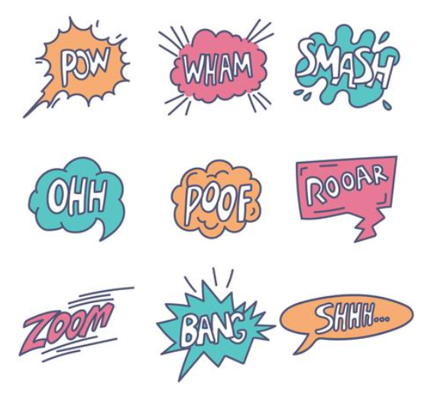
Some key features of language
Feature 1: Arbitrariness
Note: what about onomatopoeia?

Slide 50
Some key features of language
Feature 2: Discreteness
All languages are made up of discrete units at various levels of structure:
Phones [slaɪdz]
Morphemes slide-s
Words slides
Phrases these slides
Sentences these slides are amazing.

Slide 51
Some key features of language
Feature 3: Rule governedness
The discrete units of language combine in rule-governed ways – all languages have grammatical patterns.
For example:
“I am taller than him” → “I’m taller than him”
“He is taller than I am” → *“He is taller than I’m”

Slide 52
Some key features of language
Feature 4: Productivity
We can use the finite grammar of a language to compose an infinite number of utterances.
“Dr. Starr then astonished the class by producing a sentence that had never before existed in the history of the universe.”

Slide 53
Summary: Some key features of language
Arbitrariness
Discreteness
Rule governedness
Productivity

Slide 54
A brief history of linguistics
We’ve already learned that, in modern linguistics, we primarily study how language works as a system and how it functions in society.
But when and where did scholars start studying these topics?

Slide 55
Two major approaches to studying language
We can take a snapshot of a language, frozen in time, and study its structure at various levels. (synchronic)
Or, we can study how features of a language change over time. (diachronic)

Slide 56
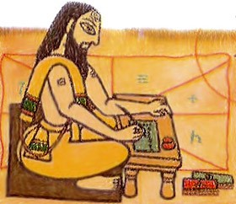
The origins of linguistics
The earliest work that we know of on synchronic linguistics was in ancient India.
Scholars such as Pāṇini were studying the structure of language from approx. the 4th century BCE.
Particularly interested in studying the structure of Sanskrit.
Pāṇini is known as “the father of linguistics.”

Slide 57
The origins of linguistics
The earliest research in Western linguistics (from the 18th cent.) was primarily diachronic, and focused on how different languages were historically related to each other.
This type of work is now called historical linguistics.

Slide 58
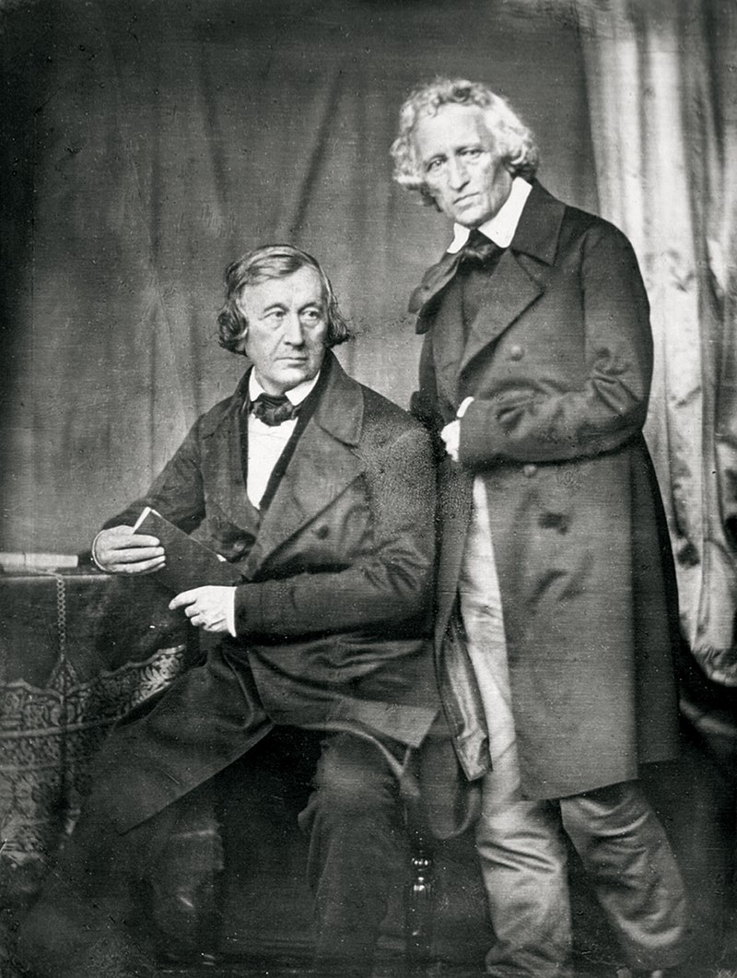
The origins of linguistics
Prominent scholars in historical linguistics included the Grimm brothers (1785-1863).
Collected regional German folktales to gather data on the history of European languages.
The fairytales they compiled (e.g., Cinderella) became hugely influential.

Slide 59
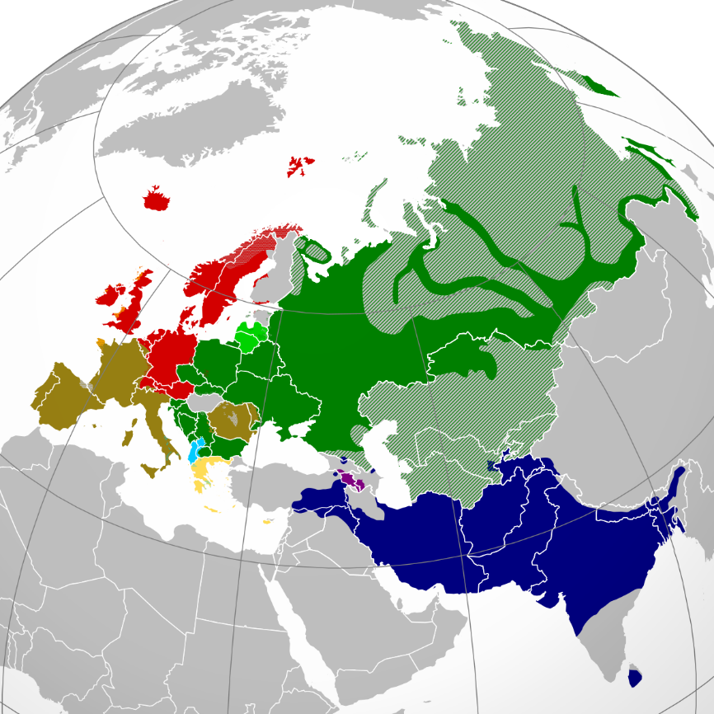
The origins of linguistics
In their investigations of the historical connections between languages, scholars realized that there was a connection between European and Northern Indian languages.
The ‘Indo-European’ language family
This prompted an interest in the older work of Sanskrit scholars.
Map of Indo-European languages

Slide 60
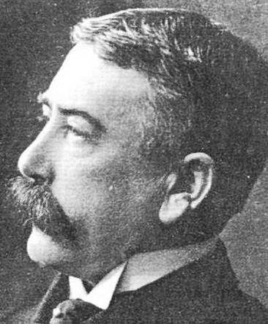
The origins of linguistics
In the 19th c., work by Pāṇini and other Sanskrit scholars was translated and published in Europe, inspiring a turn to studying synchronic linguistics.
Western linguists began to investigate language as a formal system.
Swiss linguist Ferdinand de Saussure (1857 – 1913): “the father of modern linguistics.”

Slide 61
The origins of linguistics
This approach to synchronic linguistics, sometimes called formal linguistics, came to dominate the field by the mid-20th century.
Although scholars in anthropology, philosophy, and psychology continued to study language with other approaches.

Slide 62

The origins of linguistics
Starting in the 1960s, a new wave of interest in sociolinguistics, the study of how language functions in society.
More linguists began investigating how linguistic structure varies within communities and changes over time.
American linguist William Labov (1927 – 2024): “the father of sociolinguistics.”

Slide 63
Linguistics today
Today, linguistics is a very diverse field.
Many scholars around the world study the formal structure of language.
Others study the social functions of language and how language changes over time.
Others study language and cognition, language and computing, and other topics.

Slide 64
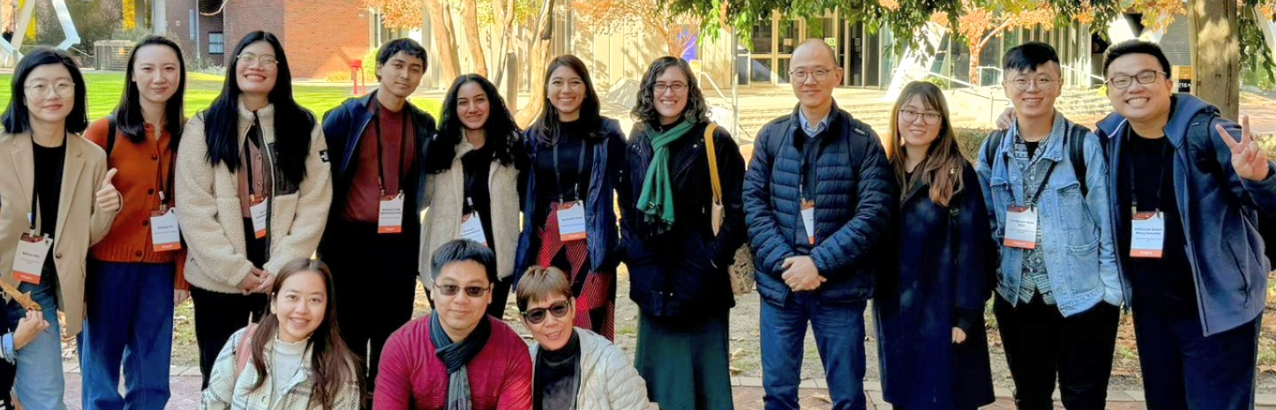
Linguistics in Singapore
Singapore is a fascinating place to study linguistics, due to its history of language contact, language planning policies, and multilingualism.
Singapore may be the country with the most linguists per capita in the world today!
Some NUS linguists at the Sociolinguistics Symposium in Perth, Australia (2024)

Slide 65
Summary: a brief history of linguistics
Synchronic and diachronic approaches to the study of language.
Modern study of synchronic linguistics has its roots in Sanskrit scholars of ancient India.
Early Western linguists interested in historical linguistics, later turned to synchronic linguistics.
Modern linguistics encompasses formal linguistics, sociolinguistics, other approaches.

Slide 66
Course logistics
Information about the course, assessments, etc. is all available in the pdf syllabus on Canvas.
Readings and other materials are also all available on Canvas.
Some key things for us in the coming weeks…

Slide 67
Course format
This is a blended learning course.
Our lectures will be online and asynchronous, while our tutorials will be in-person.

Slide 68
Lectures
Video lectures and slides will be posted every Thursday on Canvas at 10 AM.
If you have any questions about the lecture, please let me know by email or in office hours!

Slide 69
Tutorials
Tutorials will begin on Week 4.
Week 3 tutorials are canceled due to CNY.
In tutorial, we will practice sample problems to apply the concepts learned in class, review the previous homework assignment, and answer student questions.
Students will be organized into small groups within your tutorial section. Groups will work together on the weekly assignments.

Slide 70
Zooms
There will be no compulsory Zoom meetings for this course.
However, I will hold optional office hour Zooms every Friday at 2 pm, where I will review practice problems and answer questions.
Please see Canvas > Zoom for link.

Slide 71
Weekly assignments
We will have 8 weekly assignments in total.
These assignments are intended to give you an opportunity to apply what we have learned in class each week to new data.
Please work on these assignments collaboratively within your small group.
Assignments will be released on Thursdays at 10 AM and will be due the following Thursday.

Slide 72
Weekly assignments
The first assignment will have its due date extended by one week due to the CNY holiday.
Therefore, both Assignments 1 and 2 will be due on the Thursday of Week 5 (13 Feb).

Slide 73
Other assessments
In addition to the weekly assignments, you will complete:
A brief individual essay (Due Week 10)
A midterm test (Week 8)
A final test (Week 13)
More information on these assessments is available on the syllabus.

Slide 74
Test timeslots
We will arrange several timeslots on Weeks 8 and 13 for students to take the midterm and final tests.
A survey will be sent to you soon!
If you cannot make any of the pre-arranged timeslots, we will arrange a make-up time with you.

Slide 75
Communication
If you have any questions, I am happy to answer email at any time of day!
Please do check your school email and Canvas regularly for key announcements and updates.

Slide 76
Is this a hard course?
Because this is a broad survey course, we will cover a wide range of topics, research methods, and concepts, many of which will be new to you.
It’s very likely that you will find some of these areas more intuitive than others.

Slide 77
Additional resources
In addition to contacting me, the tutors, and checking the readings, here are some other resources you may find useful:
Crash Course Linguistics: YouTube series made by linguists.
(Episode 1) https://www.youtube.com/watch?v=3yLXNzDUH58
Seeing Speech: UK site with resources for phonetics.
https://www.seeingspeech.ac.uk/
All Things Linguistic: blog with links to resources for linguistics:
https://allthingslinguistic.com/post/164874346205/how-to-teach-yourself-linguistics-online-for-free

Slide 78
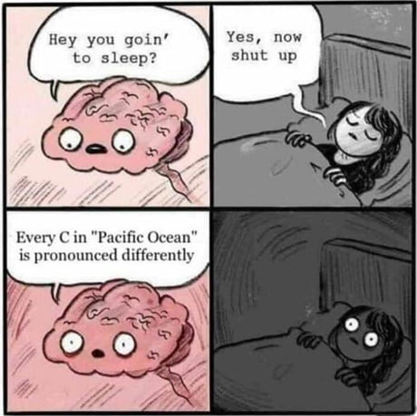
Next week
Phonetics, Part 1

